Slide 1
Consolidation and National Security
When one goes out, they all go out
R. Thompson, S. Cummings, C. Flood, B. Gilbert

Slide 2
Problem
Modern consolidation in food production allows adversaries to disrupt operations with less effort than before, potentially causing widespread food insecurity.
Example: If National Poultry Corporation produces 75% of domestic poultry products, a cyber-attack targeting them would cause starvation conditions for large numbers of people.
This has happened before!

Slide 3
Question
What cybersecurity risks arise from consolidation in critical infrastructure?
How have past cyber attacks on large companies affected national security and societal stability?
Using analogous examples, what is shown regarding the vulnerabilities of critical industry monopolization?
Consolidation in critical infrastructure sectors significantly increases negative downstream effects and creates single points of failure on an industrial scale.

Slide 4
Goals (Original)
Create guidelines for software adoption to add to private organizations existing policy
Create guidelines for the USFG to consider in M&A filings
Create guidelines for DoD (Department of Defense) when contractors attempt to consolidate

Slide 5
Goals (revised)
Two Models
Network Attack
Effects of outage on Supply Chain
Survey of IT and non-IT decision makers
Case Studies of Crowd Strike and JBS
Use above three as evidence for paper

Slide 6
Progress – Network Modeling
Purpose
This model is designed to simulate the network vulnerabilities associated with the CrowdStrike outage. It shows the effects of a potential cyberattack by illustrating how a network can be brought down, the extent of the disruption, and the timeline required for the recovery of services. The goal is to demonstrate network outage and provide insight into the time it takes to bring the network back online.

Slide 7
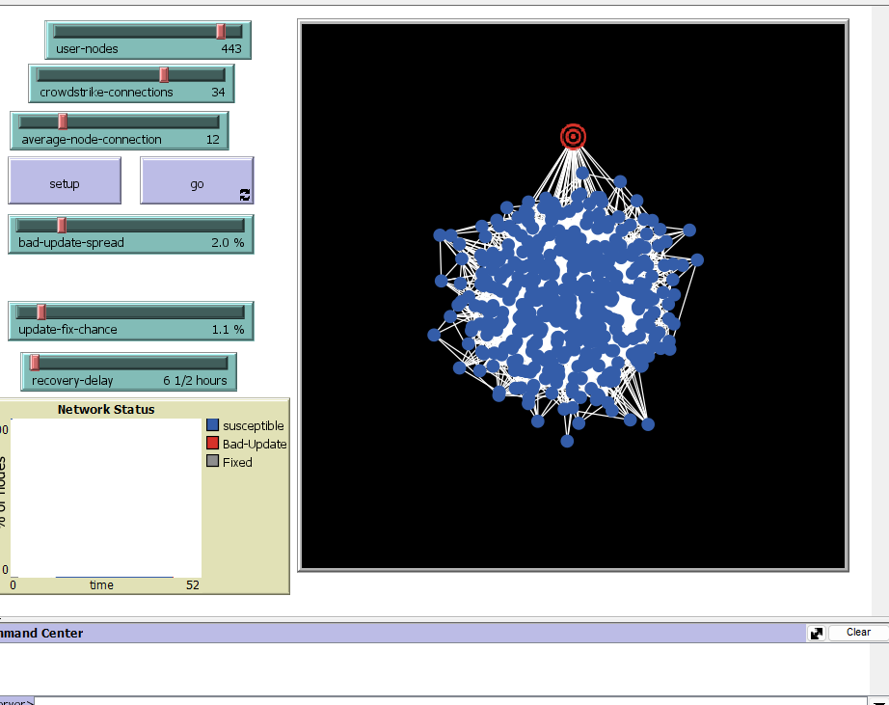
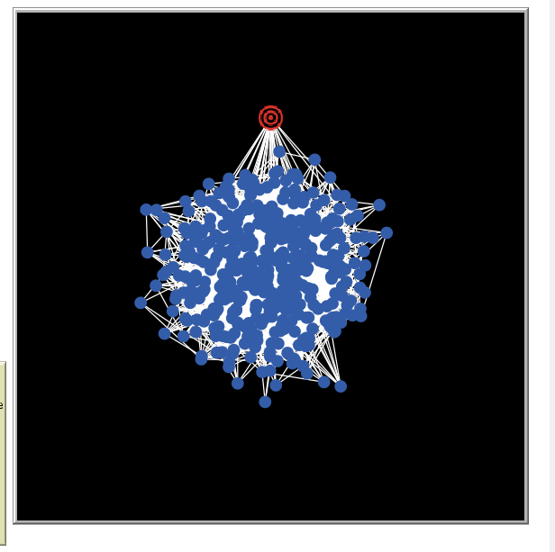
The red dot represents CrowdStrike.
Variables
Crowdstrike-connections
Number of connections to crowdstrike
Bad-update-spread is the chance of node receiving update.
Recovery-delay
Amount of time it took fix implementation.

Slide 8
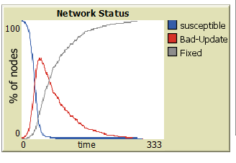
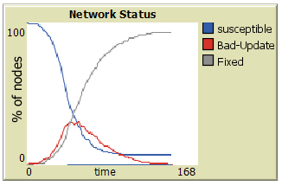
Findings – network Model
Graph 1 mimics the response delay to fix the update and the increased number of connections to Crowdstrike giving an increasing the number of nodes that received update.
Graph 2 shows decreased time response and decrease connections to Crowdstrike. This shows the recovery was faster with limited number of affected nodes.

Slide 9
Network Demo

Slide 10
Progress – Supply Chain Modeling
Purpose:
Our second model simulates the vulnerability to production shocks when major producers have reduced output due to a cyberattack (when systems are down no production can occur and the current inventory is at risk). The four large meatpacking firms in the United States are the primary focus for this model while the remaining market share is made up by smaller firms. Our team's ultimate goal would be to gather data from simulations to analyze food security metrics and national security implications when one major producer is affected (or more than one).
Major Agents:
JBS - Red Truck, has 24% of market share, primary region is Midwest
Tyson Foods – Blue Truck, has 22% of market share, primary region is West
Cargill - Green Truck, has 19% of market share, primary region is South
National Beef – Yellow Truck, has 12% of market share, primary region is Northeast

Slide 11
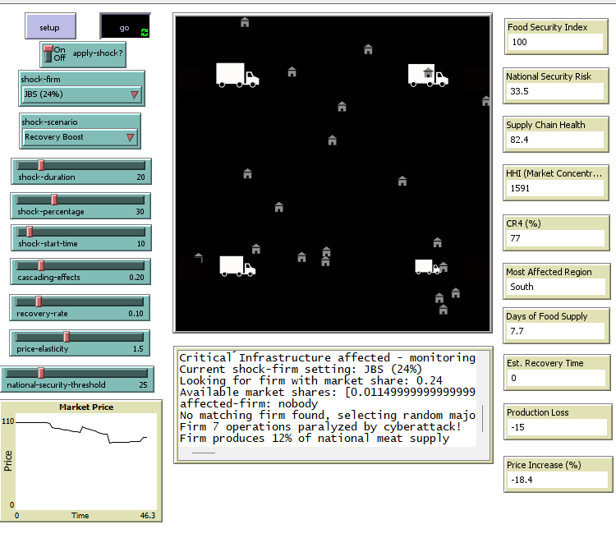

Slide 12
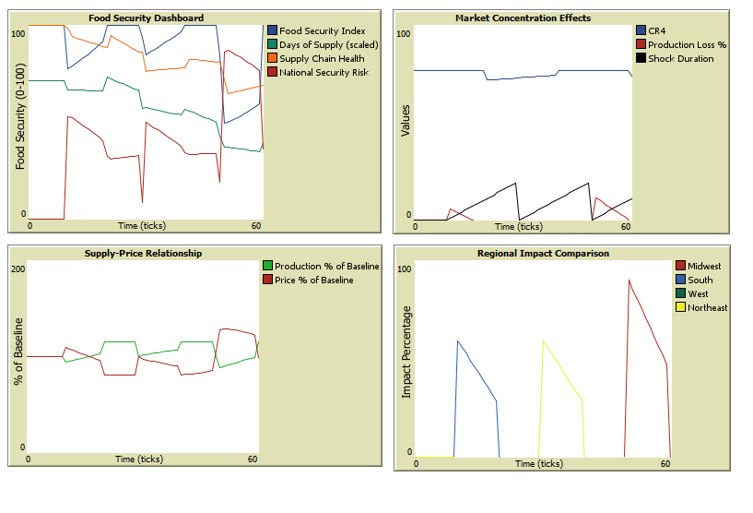

Slide 13
Progress – Supply Chain Modeling
Initial Conditions:
Each firm starts at full production capacity, 14 days of meat supply in the system, and has a food security index of 100 (best case).
Shock Scenarios:
Mild – A small-scale attack with 10% production loss and a 5 tick recovery.
Recovery – A moderate attack with 30% production loss, 20 tick recovery, but has industry support for recovery.
Severe – A major cyberattack with 50% production loss and a 30 tick recovery time.

Slide 14
Progress – Supply Chain Modeling
Key Parameters:
Shock duration: Number of ticks that the initial "shock" lasts. (0-30)The greater the duration, the greater the disruption (0-30)
Shock percentage: Production reduction during shock (10-70%). It represents the total immediate production reduction.
Recovery rate: Speed at which the affected firms recover (1-50%) per tick.
Cascading effects: The rate at which disruptions spread to other firms (0 – 100%) The higher values mean the supply chain is affected more.
Price elasticity: How prices respond to changes in supply. (.5-3.0) The higher values create more dramatic price hikes.
Shock-start time: This is the tick number when disruption begins. It allows for observing baseline values before a shock happens.
National security threshold: The risk level that simulates national security concerns (0-100). The higher the value, the more sensitive the model will report national security risks. The lower threshold means that the model will only report national security risks only in severe situations.

Slide 15
Supply Chain Demo

Slide 16
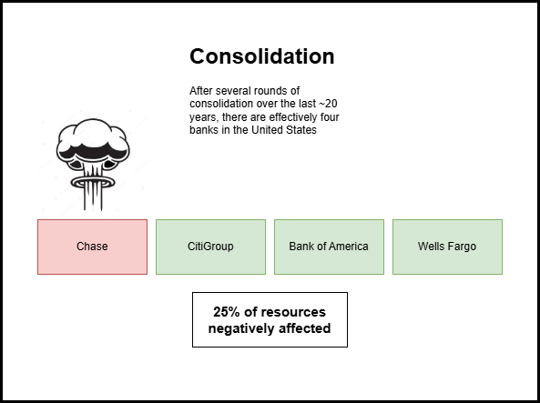
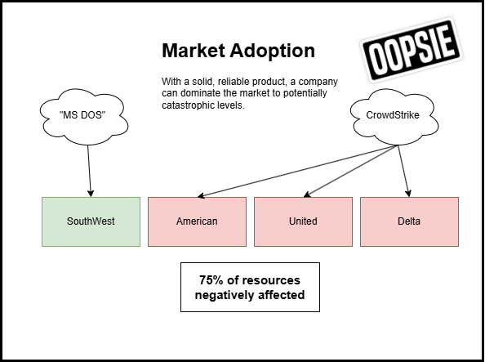

Progress – Survey/defcon
Presented modified deck (Can’t give too much away!)
Asked Approx. 30-40 people surveyed before presentation
Resulted in 20 actual responses, goal was 10, and discussion among professional practitioners
Class help with distribution?

Slide 17
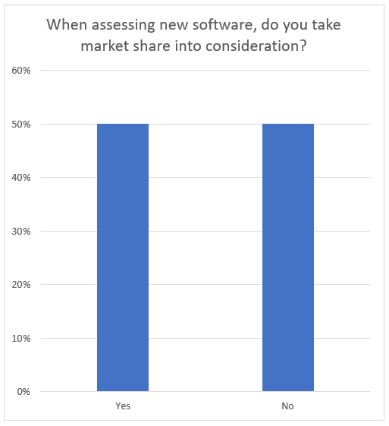
Findings – Survey/defcon402
Market-Share was split perfectly, regarding influence on decision making
Most respondents did not consider market share a significant risk. This is what we expected.
A large market share was mostly considered a positive, or had no opinion. Bottom line: No negativity associated with market share.

Slide 18
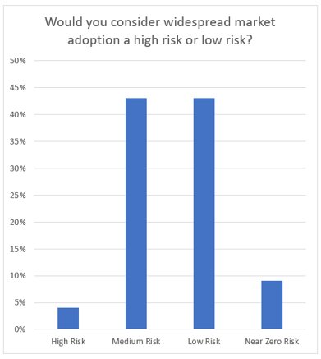
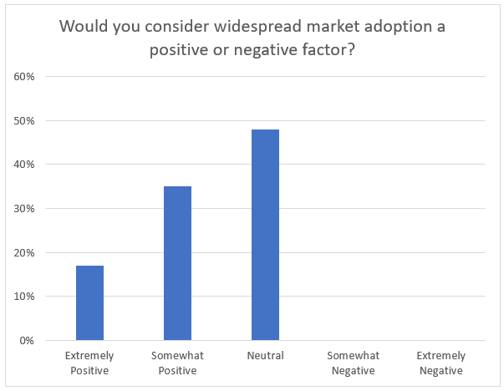

Slide 19
Progress – Case Studies
Case Studies were already completed by others
Use as evidence for final paper/report
More time for Survey and Model development

Slide 20
Findings – JBS
REvil monetized access to victim networks and sold that access to other REvil affiliates.
Before encrypting victim organization networks, REvil used double extortion methods to first steal sensitive data from victims and then publish that data on REvil’s public blog.
REvil harassed victim company employees via email and telephone to coerce the companies into paying ransoms
USDA instructed competitors to increase output
JBS was dark for a full day and incrementally came back over three days

Slide 21
Findings – Crowd Strike
Systems administrator at CrowdStrike caused the largest IT outage in American history
System administrator performed a windows update which was neither validated, verified or followed the change management approval process
There was a security flaw discover in the Falcon sensor version 7.11 and above which caused the system to crash
Billions of dollars in lost productivity and chaos
Not even a cyberattack only cyber negligence!

Slide 22
Final GOALS for M3
Continue to develop model
Get more responses for survey
Update graphics after both are complete
Create final report and paper

